Slide 1


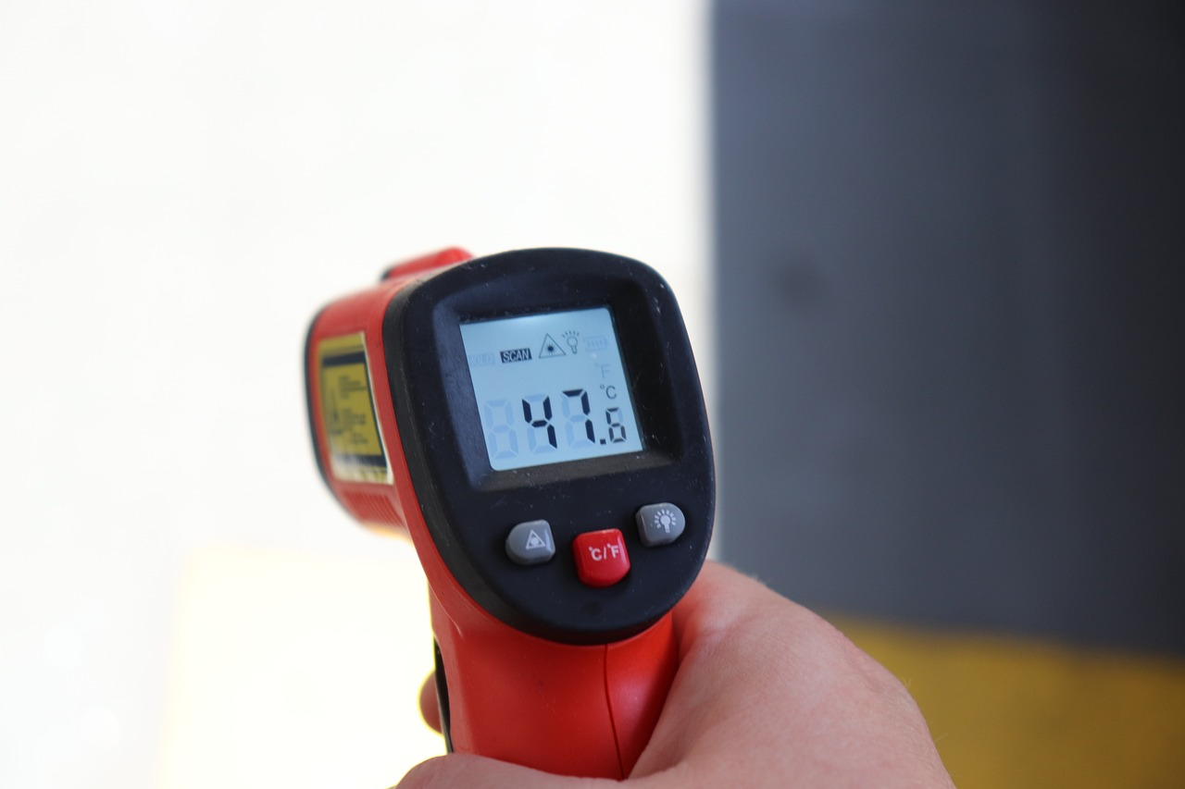
Problem solving with integers and decimals
Task A: Integers, negatives and decimals in the real world
Aisha has £13.45 credit on her school account. She spends £2.67 then spends £7.89. Aisha then puts £4.21 back into her account.
How much does Aisha have in her school account now?
2) Jun has a £20 note. He buys 4 green pens, 6 pencils and 2 orange highlighters.
The shopkeeper gave Jun £6.16 in change.
Is this correct? Show your working out.
£1.56
76p
£1.27
3) There are two places in Antarctica scientists want to investigate. They look at the temperature in the morning over 5 days.
Location 1 | −24.3℃ | −21.6℃ | −20.9℃ | −24.15℃ | −24.8℃
Location 2 | −22℃ | −21℃ | −26℃ | −24℃ | −24.8℃
Using the mean average, which is the coldest location?

Slide 2

Problem solving with integers and decimals
4) Andeep is taking part in a local Maths competition.
There are 10 questions.
Each correct answer gets 8 points.
Each incorrect answer gets (-6) points.
Each question not answered gets (-2) points.
a) Andeep answers 4 correct, 3 incorrect and misses 2 questions. How many points does he have?
4b) In a different competition, Lucas gets 36 points.
There are 8 questions.
Each correct answer gets 12 points.
Each incorrect answer gets (-4) points.
Each question not answered gets (-2) points.
Give some examples of how Lucas performed in the competition.

Slide 3



Problem solving with integers and decimals
Task B: Measurements and accuracy
1) Here is an example of two car rental companies.
Rent-a-Red-Car
1 km = £0.46
Rent-a-Blue-Car
2500 m = £1.10
An Oak teacher knows he will need to rent a car for a 70 km journey. Work out the difference in prices between the two companies for a 70 km car hire.
2) Sofia helps her neighbour feed her cats using a feeding chart.
Mass to the nearest 10 g | Quantity of dry food per day
🐱 1 - 2.99 kg | 70 g
🐱 3 kg - 4.99 kg | 90 g
🐱 5 - 5.99 kg | 100 g
🐱 more than 6 kg | 115 g
1.5 kg of dry food
£9.82
Her neighbour has three cats weighing 4.5 kg, 5.1 kg and 6.2 kg.
How much will it cost to feed all three cats for 2 weeks?
Mathematics in Education and Industry
v2.1

